Slide 1

Multilingual News Summarizer using AI Techniques
Ayush Gondhali (22106124)
Tanuj Kokamkar(22106088)
Harsh Jain(22106117)
Krishna Mishra(22106131)
Project Guide
Prof. Tejashri Kolhe
Notes:
1

Slide 2
Outline
Introduction
Literature Survey of the Existing Systems
Limitations of the Existing Systems
Proposed System Design
Framework/Algorithm
Technologies Stack for Proposed System
Implementation
Conclusion
References
Notes:
2

Slide 3
Introduction
The massive influx of daily news, users face difficulty processing large volumes of information in real time. News articles are often lengthy and time-consuming to read.
Many people miss out on important news because it’s not available in their preferred language.
While summarization tools exist, they often work independently and lack the ability to summarize, leading to a cohesive user experience.
Notes:
3

Slide 4
Motivation Objectives
To provide a seamless tool that can both summarize and translate news into a user’s preferred language would save users time and enhance accessibility for non-native speakers.
To provide real-time translation of the summarized content into multiple languages, enabling access to global news.
To create a system that condenses lengthy news articles into concise summaries while maintaining key information and context.

Slide 5
Literature Survey
Name of Research paper | Author | Summary
"A survey on extractive text summarization." IEEE Access 10 (2022) | By Moratanch, N., and S. Chitrakala. | Text Summarization is the process of obtaining salient information from an authentic text document. In this technique, the extracted information is achieved as a summarized report and conferred as a concise summary to the user.
" Performance study on extractive text summarization using BERT models." International Journal of Innovative Research in Applied Sciences and Engineering (IJIRASE) 4, no. 11 (2021). | By Abdel-Salam, Shehab, and Ahmed Rafea | The task of summarization can be categorized into two methods, extractive and abstractive. Extractive summarization selects the salient sentences from the original document to form a summary while abstractive summarization interprets the original document and generates the summary in its own words
Notes:
5

Slide 6
Limitations of Existing Systems
Multilingual News: Many models struggle with summarizing content across multiple languages effectively.
Data Dependency: Requires large, high-quality datasets for training, which are often unavailable or biased.
Integration: Systems either summarize or translate the News , but not both
Notes:
6

Slide 7
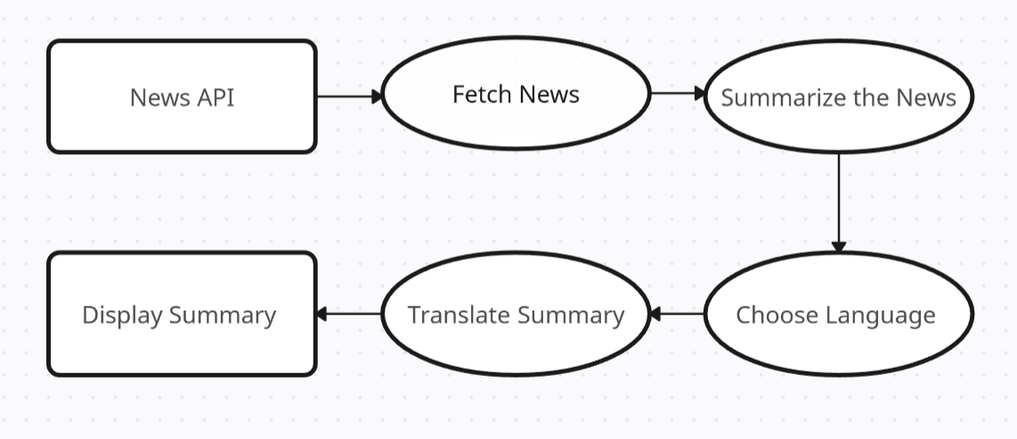
Proposed System Design
Notes:
7

Slide 8
Framework /Algorithm
News is fetched from a news API
The news is summarized.
It is followed by translation into the user’s selected language.
A simple interface where users can view a news article and choose their preferred language for the translated summary.

Slide 9
Technology Stack for Proposed System
HTML5
CSS3
Python
Google News API
Flask
Beautiful Soap
NLTK
PyTorch
Notes:
9

Slide 10
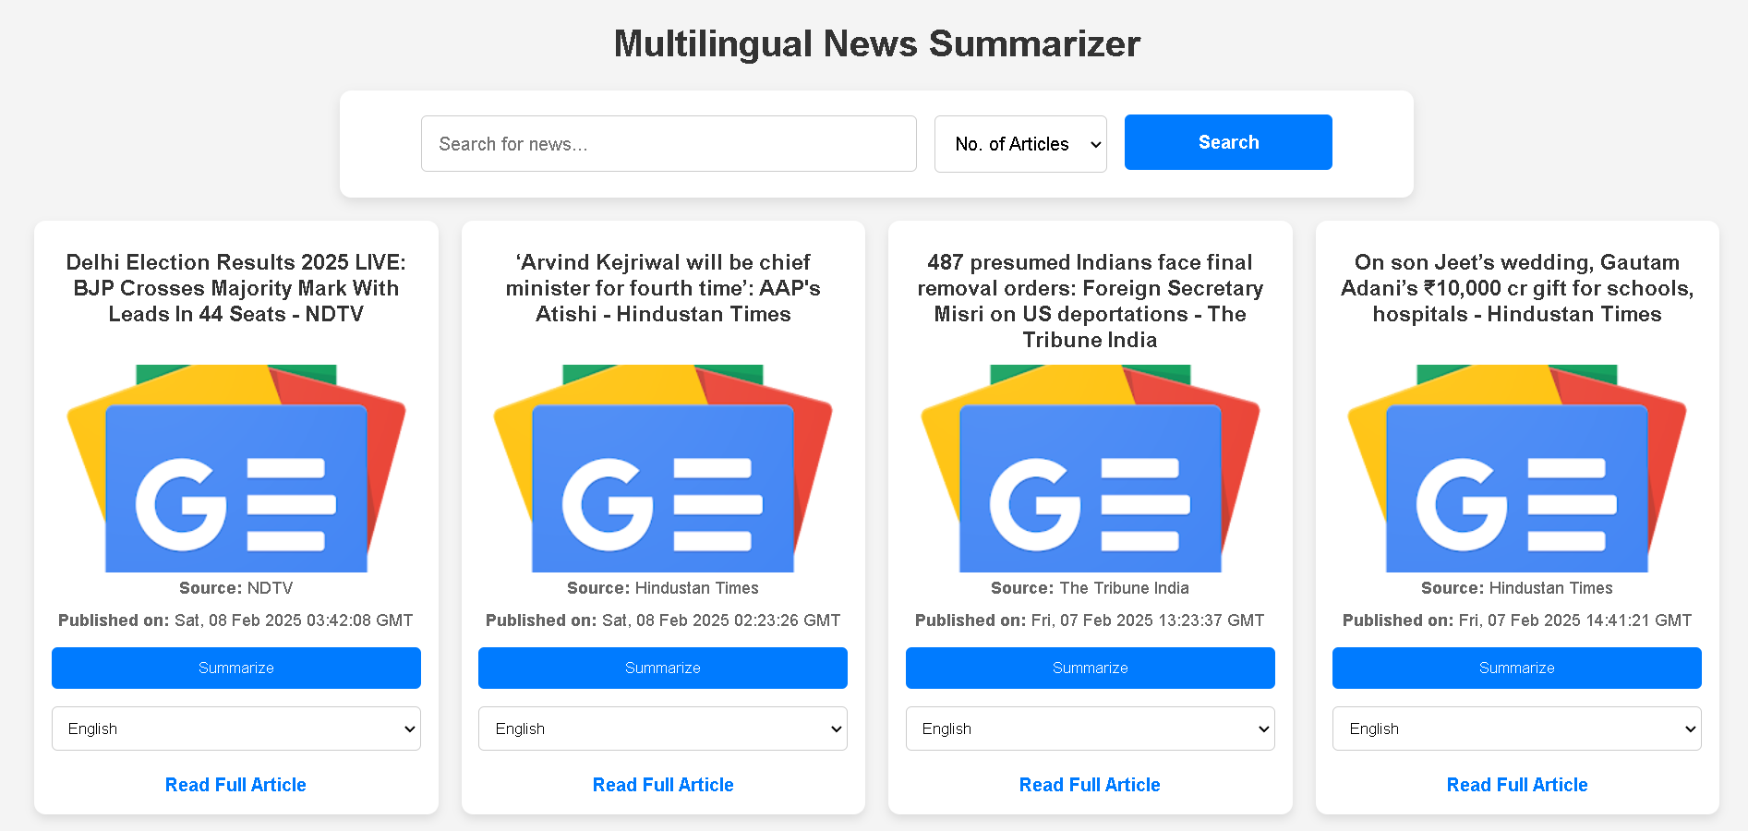
Implementation
Notes:
10

Slide 11
Conclusion
The project successfully integrates news summarization and translation, providing a more personalized news-reading experience.
Addressed common issues such as translation accuracy, summarization quality, and real-time processing.
Potential future work includes adding support for more languages and optimizing the translation system
Notes:
11

Slide 12
References
"A survey on extractive text summarization." IEEE Access 10 (2022): By Moratanch, N., and S. Chitrakala.
" Performance study on extractive text summarization using BERT models."
International Journal of Innovative Research in Applied Sciences and Engineering (IJIRASE) 4, no. 11 (2021).
3 Abdel-Salam, Shehab, and Ahmed Rafea. "Performance study on extractive text summarization using BERT models." Information 13, no. 2 (2022): 67.
4 Widyassari, Adhika Pramita, Supriadi Rustad, Guruh Fajar Shidik, Edi Noersasongko, Abdul Syukur, and Affandy Affandy. "Review of automatic text summarization techniques & methods." Journal of King Saud University-Computer and Information Sciences 34, no. 4 (2022).
Notes:
12

Slide 13
Thank You...!!
Notes:
13

